Slide 1
ONTARIO · TRANSPORT CANADA CAMES
Fill your medical exam schedule.
OneMedPass is an online booking platform that connects Ontario pilots with designated Civil Aviation Medical Examiners — and runs your day around the hours you set.
OneMedPass
01 / 17

Slide 2
THE PROBLEM
Medicals are still booked by phone tag.
01
02
03
Pilots can't find you
Staff time
Gaps and no-shows
They call down a list until someone answers.
Every booking costs a phone call, a callback and a paper note.
Empty slots you never got the chance to fill.
OneMedPass
02 / 17

Slide 3
WHAT IT IS
One page pilots book from. One dashboard you work from.
Pilots search by city, medical category and language, pick a real open time, and the exam lands on your calendar with everything you need to see them.
No app for the pilot to install — it works in the browser
Nothing is bookable outside the hours you publish
You keep the clinical relationship; we handle the scheduling
OneMedPass
03 / 17

Slide 4
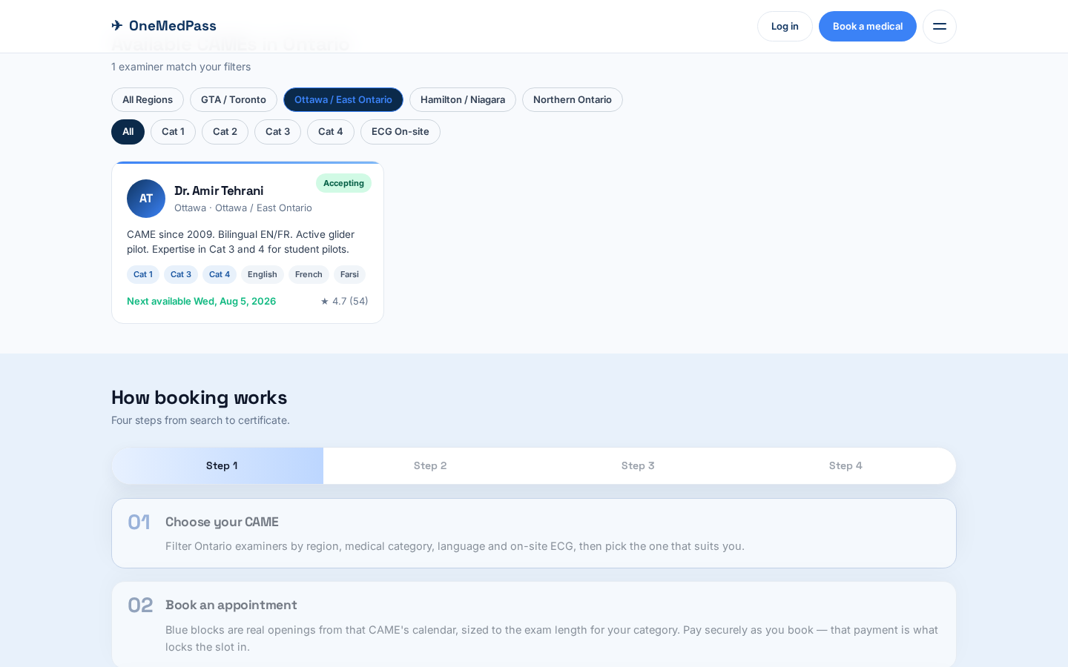
PILOT VIEW
They find you by region, category and language.
Pilots filter Transport Canada examiners by location, medical category, language and ECG on-site — then pick the CAME that fits them.
OneMedPass
04 / 17

Slide 5
YOUR DASHBOARD
Your week, in one screen.
01
02
03
My week
Appointments
Reach the pilot
A seven-day calendar with every exam colour-coded by status.
A simple table: pilot, category, time, licence, status.
Tap to call or email, or message them inside the app.
OneMedPass
05 / 17

Slide 6
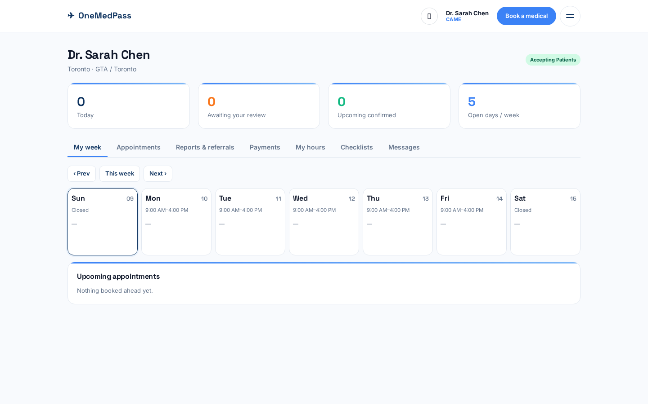
CAME VIEW
Every appointment, colour-coded by status.
The My week calendar shows your open days, today's count, pending reviews, confirmed exams and upcoming appointments at a glance.
OneMedPass
06 / 17

Slide 7
CONTROL
You decide when you're open. Always.
Weekly hours per day, with a lunch break
Exam length per category — e.g. 60 min Cat 1, 45 min Cat 2, 30 min Cat 3/4
Date overrides for conferences, vacation or a short Friday
Turn 'accepting new patients' off any time
OneMedPass
07 / 17

Slide 8
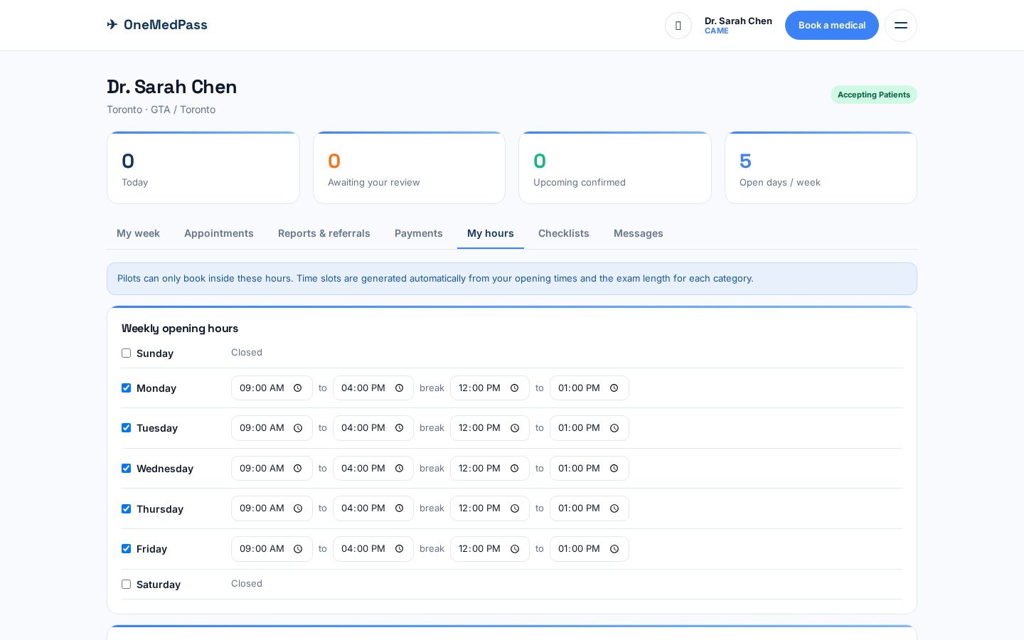
AVAILABILITY
Publish your weekly hours once. Slots generate automatically.
Set open days, start/end times and lunch breaks. OneMedPass builds the blue booking blocks from your real availability and exam length.
OneMedPass
08 / 17

Slide 9
VISIBILITY
Listed where Ontario pilots are already looking.
01
02
03
By location
By category
By language
City and region, so local pilots reach you first.
Cat 1–4, plus ECG on-site as a filter.
The languages you practise in are shown on your card.
OneMedPass
09 / 17

Slide 10
THE PILOT'S SIDE
Six steps, then it's on your calendar.
1
Choose category
2
Pick a day
3
Pick an open time
4
Pilot details
5
Pre-exam checklist
6
Pay securely — booking confirmed
Bookings only land inside hours you opened, and they arrive already paid. Cancel one and the pilot is refunded in full, automatically.
OneMedPass
10 / 17

Slide 11
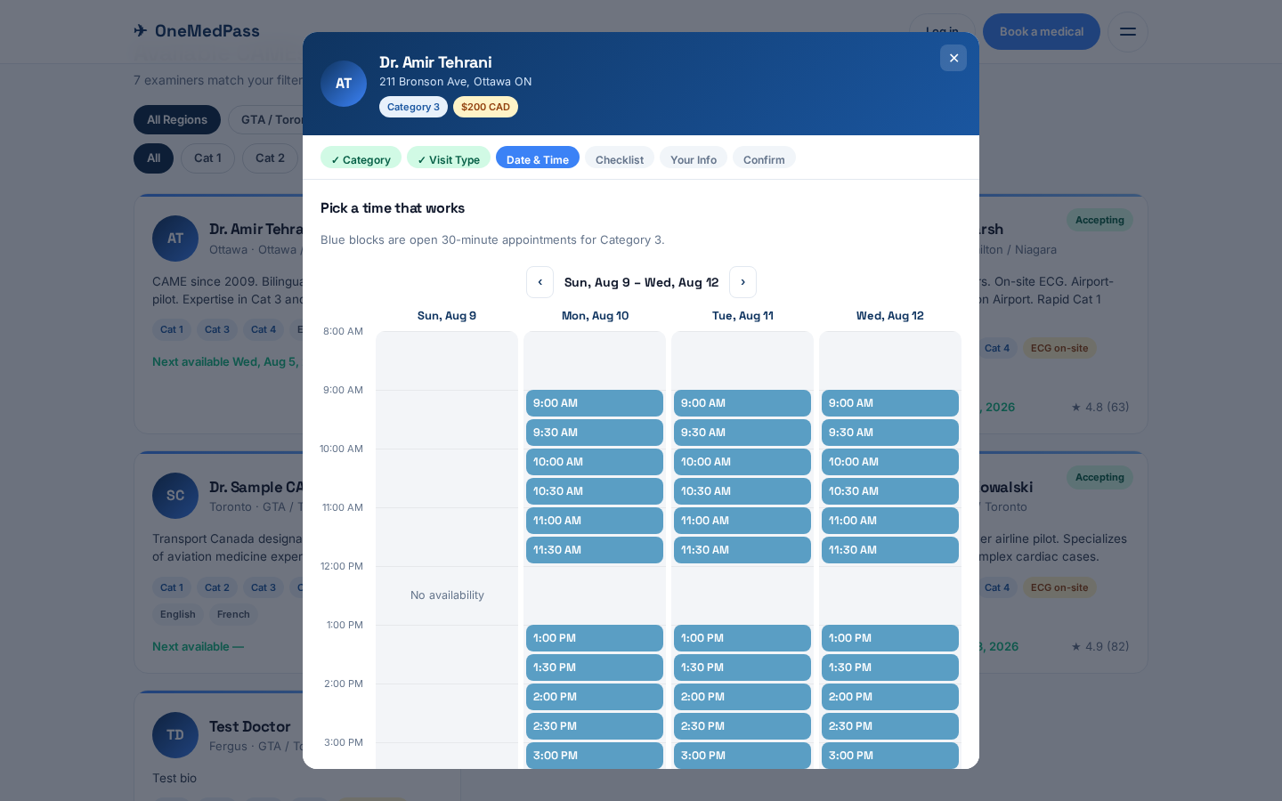
BOOKING
Blue blocks are real openings from your calendar.
Pilots only see slots that actually fit the exam length and your published hours. They pick one, pay, and the booking is confirmed instantly.
OneMedPass
11 / 17

Slide 12
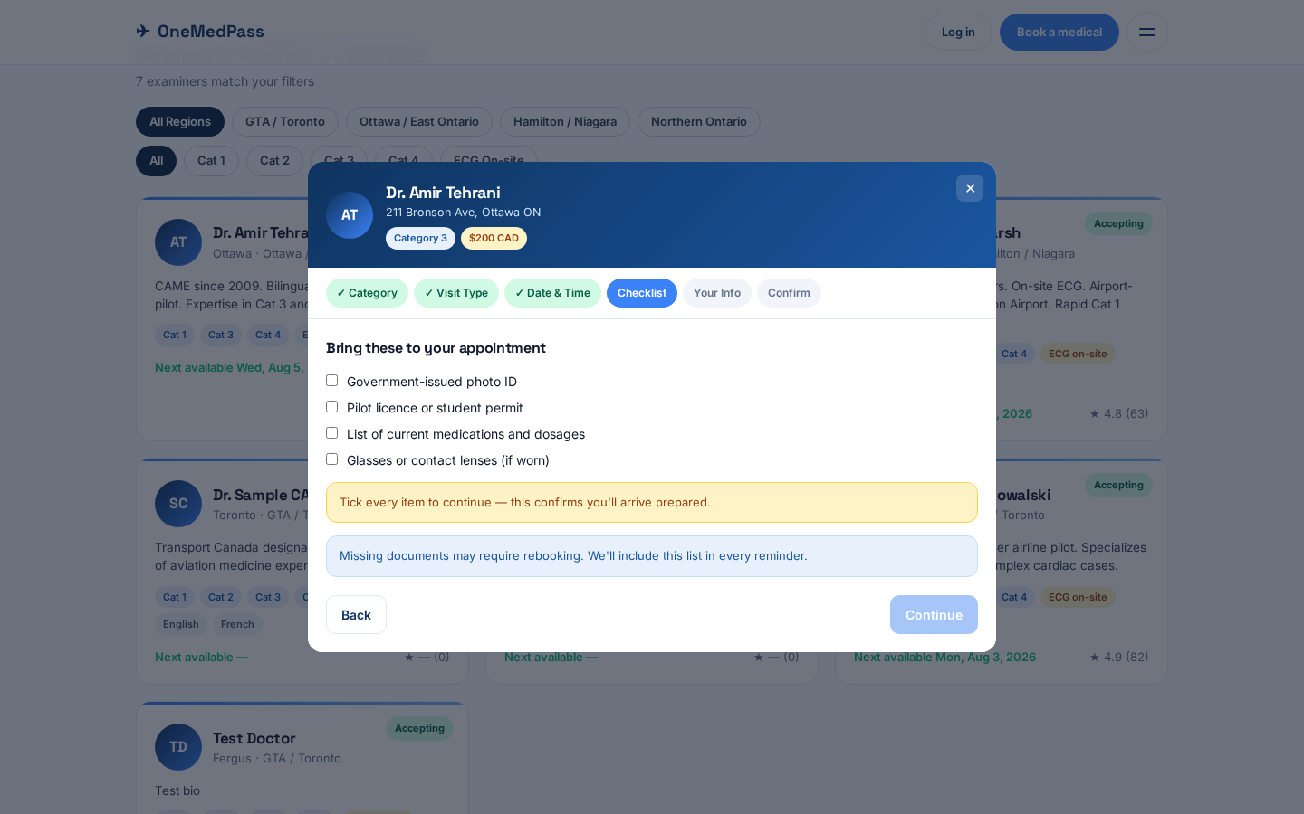
PREPARED PILOTS
Pilots confirm what to bring before they arrive.
You publish a checklist for each category. The pilot ticks every item before booking, so they show up with the right documents.
OneMedPass
12 / 17

Slide 13
COMMERCIALS
What it costs, what you keep.
01
02
03
Your exam fee
3% booking fee
Paid immediately
You set the price for each category. Pilots pay it online at booking, which confirms the slot.
OneMedPass keeps 3% of the exam fee. No monthly cost, no listing fee, no lock-in.
Your share is transferred to you as soon as the pilot books. We never hold your money.
Cancellations 24 hours or more before an appointment are refunded to the pilot in full. Card processing fees are charged at standard rates.
OneMedPass
13 / 17

Slide 14
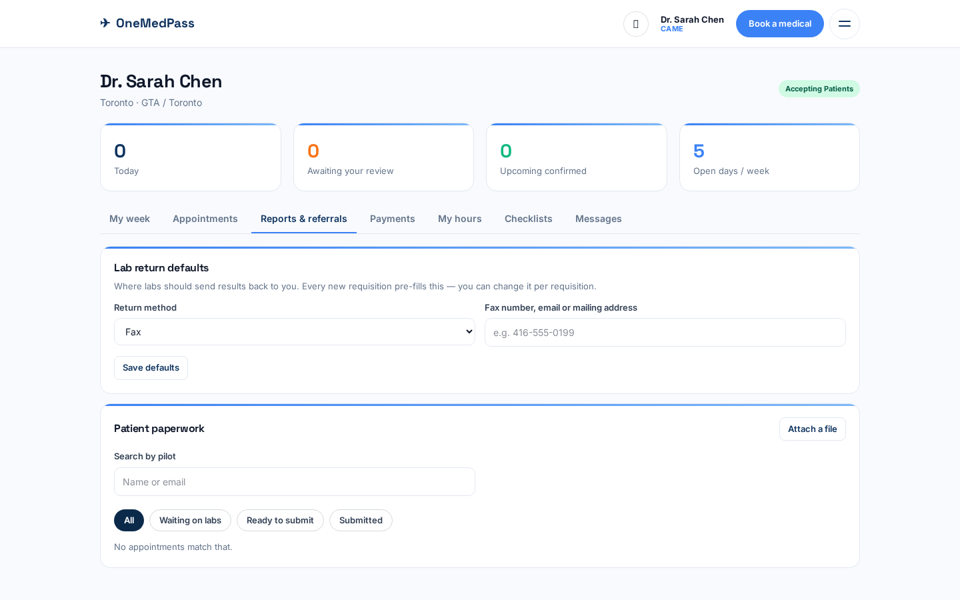
AFTER THE EXAM
Track paperwork and lab reports per pilot.
Attach reports, send lab requisitions and mark files ready for Transport Canada submission — all searchable by patient name in one place.
OneMedPass
14 / 17

Slide 15
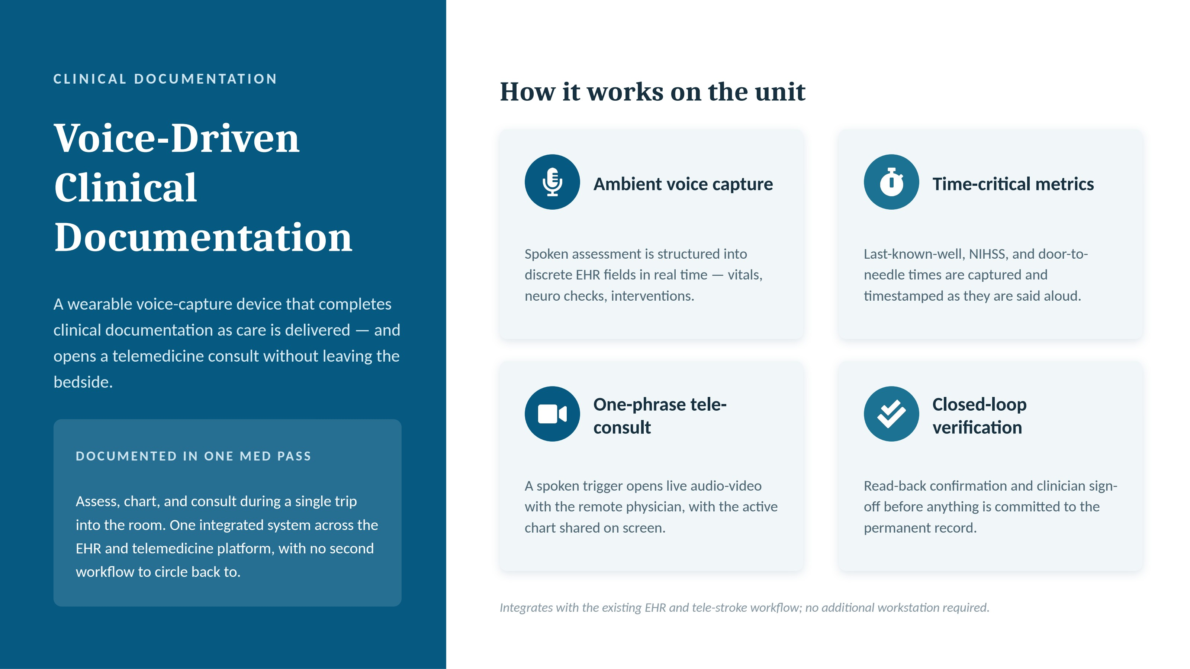

Slide 16
ONBOARDING
Bookable the same day.
1
We create your clinic profile and login
2
You give us your payout details (about two minutes)
3
You set your hours and exam lengths
4
Your listing goes live to Ontario pilots
OneMedPass
16 / 17

Slide 17
NEXT STEP
Let's get you listed.
Send us your clinic name, city and the categories you examine — we'll set the profile up and send your login.
admin@onemedpass.com · +1-416-844-0974
OneMedPass
17 / 17

